Slide 1

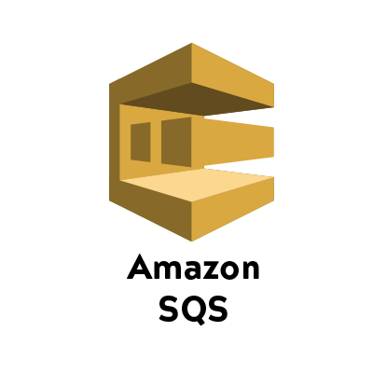

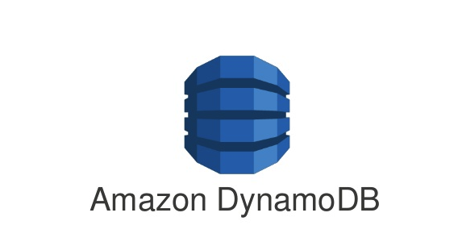
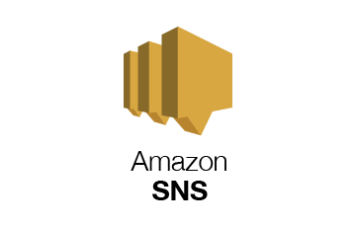
S3 to DynamoDB Data Transfer Application
Post Records On Success
Csv file posted in s3
Requests sent to sqs to process one file at a time
Send Mail Notifications On Failure
File Processed And Records Converted To DynamoDb compatible json

Slide 2
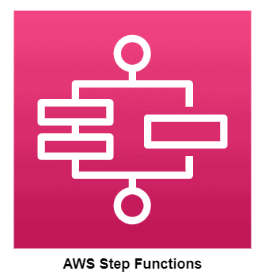

Grocery Transaction Daily Report Generation
Collect Daily Transactions From DynamoDB and post it to s3
Post Request To DynamoDB
Run Query On Athena And Post Reports
Notify Once Report Is Posted

